Slide 1
Lab 8: Loop Modeling
Presented by Alex Boukhvalova June 9th, 2016

Slide 2
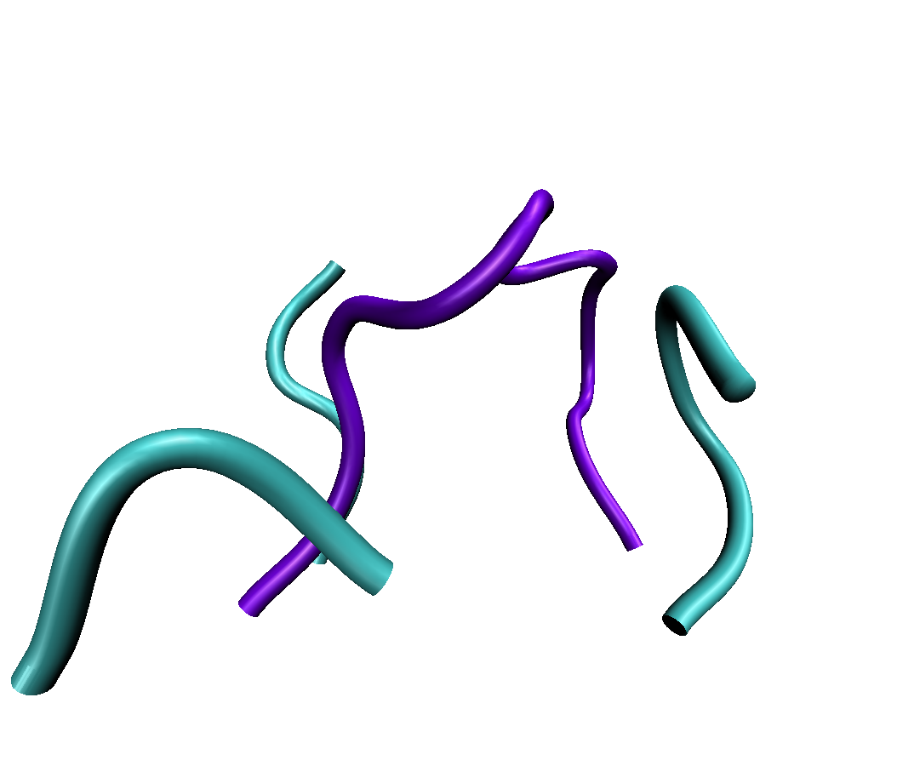
Loops
Flexible domains of the protein
Serve as ‘connecting points’ for secondary structure elements
Important for assembly, binding specificity, etc
Large available conformational space (flexible!)

Slide 3
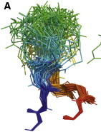
Current Challenges for Loops
Large conformational space -
only accurate to ~12 residues
Discriminating the native loop
structure from a diverse set of
loop models
Needed for:
Docking
Antibodies
Homology Modeling
Membrane proteins
And many more...
Weitzner et al. Structure, 2015

Slide 4
Loops Algorithms in Rosetta
CCD (Canutesca + Dunbrack / Wang + Bradley)
Fragment insertion followed by closure via small perturbations
KIC (Kortemme Lab)
Randomly perturb the loop then compute analytical solutions to find a closed conformation.
StepWise Assembly (Das Lab)
Enumerate every conformation during building. Use CCD at the end.
Notes:
SWA is not in loops framework, but works as well or better than KIC for some cases. The paper was amazing, the code is very good OOP, and the SWA framework can be expanded thanks to excellent coding by Rhiju.

Slide 5
Outline of the Code
Low-level Movers implement loop closure recipes (KIC, CCD)
High-level Movers implement loop sampling/remodeling protocols
loopmodel.<application>
RosettaScripts integration

Slide 6
Current state of the code
Low-level Movers implement loop closure recipes (KIC, CCD)
These work acceptably well, although their OO leaves something to be desired
High-level Movers implement loop sampling/remodeling protocols
These suffer from very serious code duplication problems (focus of refactoring)
loopmodel.<application>
RosettaScripts integration

Slide 7
Current state of the code
Low-level Movers
High-level Movers
loopmodel.<application> depends mostly on LoopRelaxMover
Hierarchy of string-from-command-line lookups versus high-level LoopMovers
Nearly abandoned from a development perspective, but still the most common interface into loop modeling as an application
RosettaScripts integration
A feature of the ongoing refactoring, integration improving at a good pace
Notes:
Hard to perfect during development. Most code projects involve some sort of refactoring as hindsight is always 20/20.

Slide 8
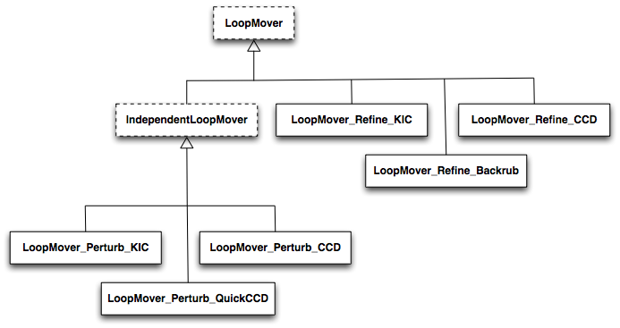
Loopmodel (app) hierarchy

Slide 9
How to Use the Loop Movers
Setup a Loops object
Loop my_loop = protocols::loops::Loop(start, end, cutpoint);
Loops my_loops;
my_loops.add_loop(my_loop);
Apply Loop FoldTree to pose (CCD only)
(protocols/loops/loops_main.hh)*
fold_tree_from_loops(pose, my_loops, pose.fold_tree(), false);

Slide 10
Using the existing Loop Movers
Switch to centroid residue type set for a Perturb flavor
(protocols/simple_moves)
switch = SwitchResidueTypeSetMover("centroid");
recover = ReturnSidechainMover(pose);
switch.apply(pose);
Create a fragset from a file if using Perturb_CCD
(core/fragment)
ConstantLengthFragSetOP frags = new
ConstantLengthFragSet(fraglength, fragset_fname);

Slide 11
Using the existing Loop Movers
Pick your flavor:
(protocols/loops/loop_mover/perturb) (need centroid…)
LoopMover_Perturb_CCD
LoopMover_Perturb_QuickCCD
LoopMover_Perturb_KIC
(protocols/loops/loop_mover/refine)
LoopMover_Refine_CCD
LoopMover_Refine_KIC
LoopMover_Refine_Backrub
Apply the Loop Mover:
my_loop_mover->apply(pose)

Slide 12
CCDLoopClosureMover
Just a Mover
Construct default, or with Loop object, or others
CCDLoopClosureMover(
protocols::loops::Loop const & loop,
core::kinematics::MoveMapCOP mm );
Could use setters within the class
No sampling - just closes loop and returns
(the phi/psi move of your protocol is “sampling”)

Slide 13
Lab
Protocol so far introduces chainbreaks
minimizer + closure patches/terms helps
Today, add explicit loop closure with CCDLoopClosureMover
You will find using the Mover is very easy
That’s the point
Some challenge in refactoring your code into a C++ class prepared to provide the correct Loop class at closure time

